Slide 1
IDENTIFYING LOSS-MAKING PRODUCTS USING SALES DATA
Presented by:
S. Akshidha
B.Sc. Mathematics

Slide 2
Problem Statement
Sales revenue alone does not indicate the actual profitability of a business.
Product costs, discounts, and shipping expenses affect profit.
The business needs to identify areas with low or negative profit.
Product, regional, and monthly performance must be analyzed.
An effective way to summarize sales and profit data is required.

Slide 3
Project Objectives
To analyze sales revenue and profit across products.
To compare business performance across regions.
To examine monthly profit trends.
To analyze the relationship between discount levels and profit.
To identify negative-profit transactions.
To create an interactive Excel dashboard.

Slide 4
Dataset Description
Total Records: 6,000
Time Period: January–December 2025
Total Columns: 13
Data Type: Retail sales data
Tool: Microsoft Excel 365
Important Fields:
    Order Date, Product Name, Category, Region, Quantity, Unit Cost, Discount Percentage, Revenue, Shipping and Other Costs, Profit/Loss

Slide 5
Problems Identified and Solutions
Business Problem | Solution
Revenue alone does not show profitability. | Analyzed both revenue and profit.
Product performance is difficult to compare. | Created product-wise PivotTables and charts.
Regional performance is unclear. | Compared revenue and profit by region.
Monthly profit changes are difficult to track. | Created monthly trend analysis.
Discounts may affect profitability. | Compared profit across discount levels.
Negative-profit transactions need investigation. | Examined transactions containing negative profit values.

Slide 6
Methodology
Collected and organized retail sales data.
Combined the records into one worksheet.
Reviewed revenue, costs, discounts, and profit/loss values.
Created Pivot Tables to summarize the data.
Developed Pivot Charts to visualize the results.
Added slicers for interactive filtering.
Created an Excel dashboard to present key findings.
Profit/Loss Formula:
Profit/Loss = Revenue − Total Product Cost − Shipping and Other Costs

Slide 7
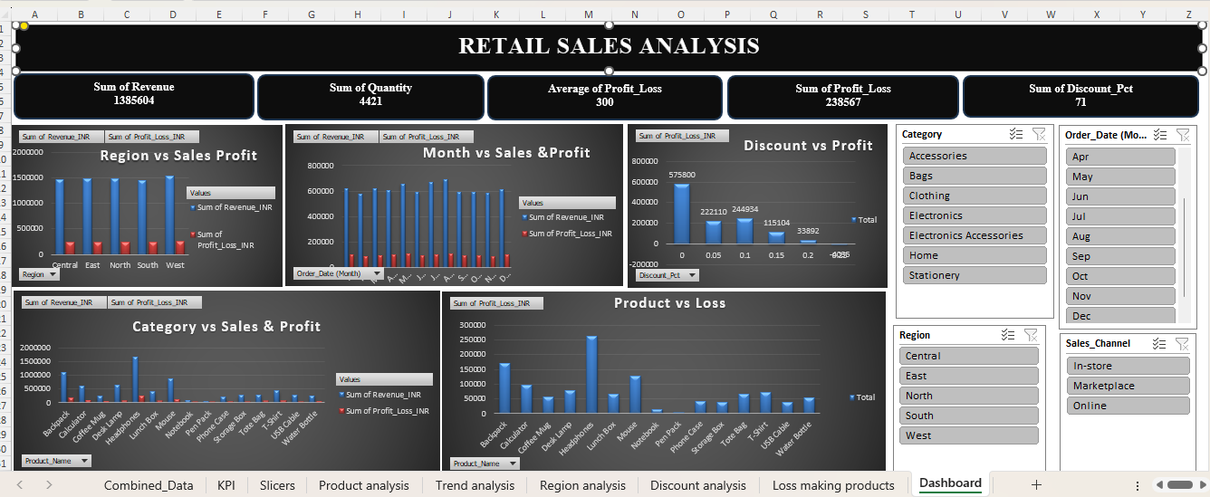
Excel Dashboard
Interactive Sales and Profitability Dashboard
Key Dashboard Components:
  Total Revenue, Total Profit, Product Analysis, Regional Analysis, Monthly Profit Trends, Discount Analysis, Interactive Slicers
  .

Slide 8
Key Findings and Insights
1. Product Performance
Headphones recorded the highest revenue of ₹16,78,903.16.
Headphones recorded the highest profit of ₹2,62,890.50 among the listed products.
2. Regional Performance
West recorded the highest revenue of ₹15,28,512.24.
West recorded the highest profit of ₹2,48,127.37.
3. Monthly Performance
May recorded the highest monthly profit of ₹1,11,528.76.
November recorded the lowest monthly profit of ₹88,233.18.
4. Discount Analysis
The 25% discount group recorded a negative total profit of ₹4,035.09.
The relationship between discounts and other costs requires further investigation.
5. Loss-Making Products
Several individual transactions contain negative profit values.
The current product-level PivotTable shows positive total profit for all 15 listed products.

Slide 9
Recommendations
Review the costs and selling prices of negative-profit transactions.
Investigate the products and costs contributing to losses in the 25% discount group.
Evaluate discount strategies to protect profitability.
Monitor monthly profit regularly.
Compare product profit margins, not just revenue.
Improve the product-level loss analysis to identify products that consistently generate losses.

Slide 10
Conclusion
The project analyzed 6,000 retail sales records using Microsoft Excel 365.
Pivot Tables and charts helped summarize sales and profitability.
Headphones was the strongest product by total revenue and profit among the listed products.
West was the strongest region by total revenue and profit.
May had the highest monthly profit, while November had the lowest.
The 25% discount group recorded a negative total profit.
The dashboard provides useful insights to support business decisions.
Final Outcome: The analysis helps the business understand sales and profit patterns and identify areas requiring further investigation.

Slide 11
THANK YOU !!!

